Slide 1
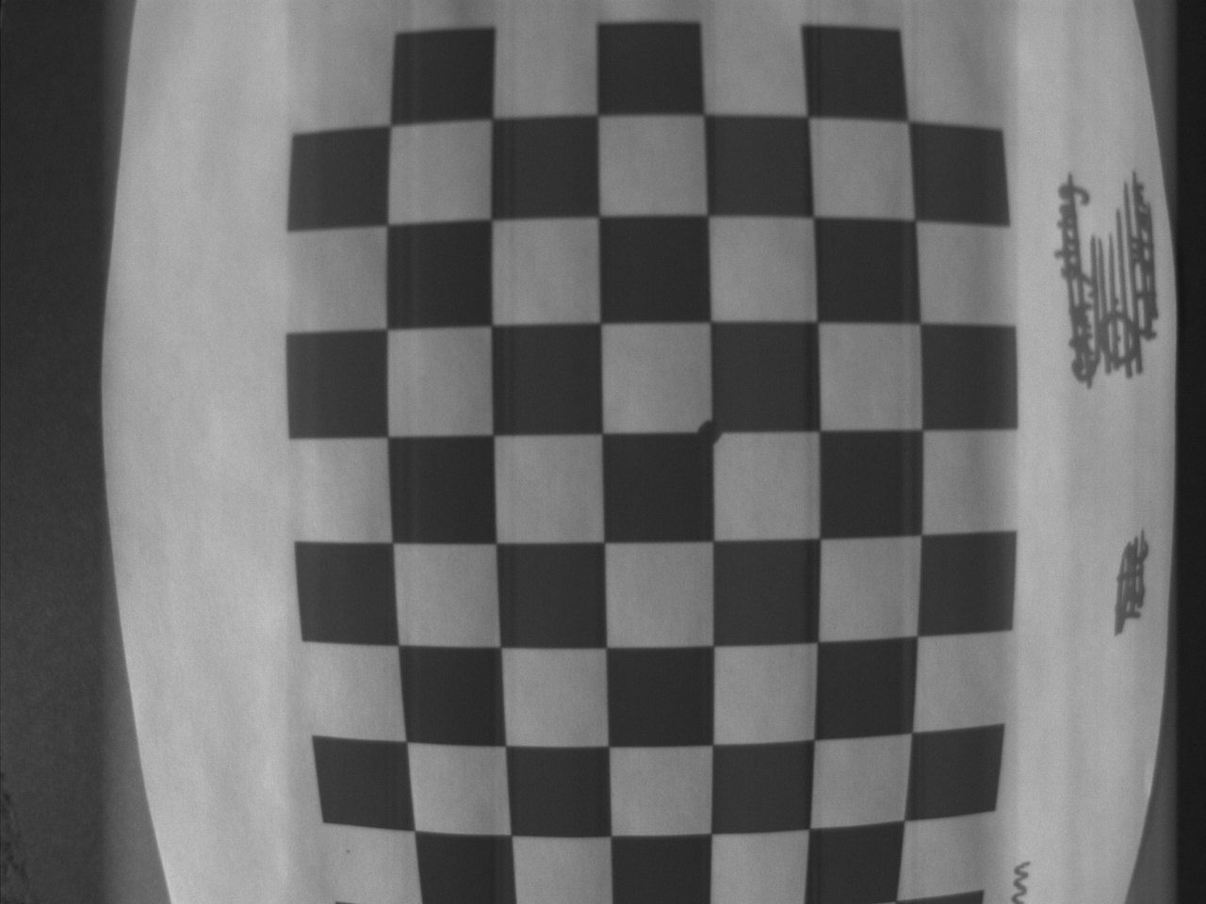
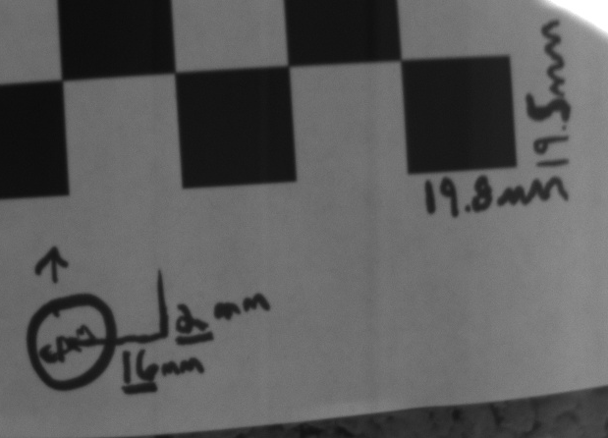
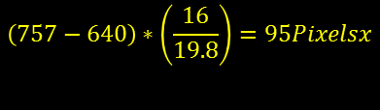
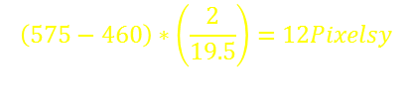
Straight Down
Image Center
(640,480)
460y
$$\left(575−460\right)∗\left(\frac{2}{19.5}\right)=12Pixelsy$$
Cam Pointing
(662,472)
575y
640x
757x
$$\left(757−640\right)∗\left(\frac{16}{19.8}\right)=95Pixelsx$$
-1.263deg Yaw= Angle between 662x and 640x
-0.456deg Pitch = Angle between 480y and 472y

